Slide 1
“Bankable” Construction Contracts
“Advantages and pitfalls of construction contracting structures (from EPC to multi-contract)”
Andrew Penfold, Counsel, Linklaters LLP
22 May 2019

Slide 2
Agenda
Construction contract structures (and standard forms)
How does project finance impact (complicate?) construction procurement?
What is “bankability”?
What are the core “bankability” issues?

Slide 3
Construction Contract Structures

Slide 4
Common structures
Construct only (and design only, supply only etc…)
Design & construct
EP+C
EPC/Turnkey
Multi-contract

Slide 5
Common structures – impact on risk allocation
1
Turnkey Structure
2
Split Package Structure
3
Direct Procurement Structure
(
single contractor)
(Multiple main contractors)
(multiple package)
EPCM/Project Management
EPC Contractor
Owner
Owner
Contracting
Approach
Number of
Contracts
1
2
-
6
>
100
with the
Owner
Contractual relationship with the Owner
No Contractual relationship with the Owner

Slide 6
Other structuring concepts
“Split” Contracts (Onshore / Offshore)
World Bank procurement rules
Front-End Engineering and Design
Limited Notice to Proceed (LNTP) / Full Notice to Proceed (FNTP)
Technology licensing
Convertible LSTK
EPCM, Managing Contractor and Project Management
Alliancing (and relationship contracting)

Slide 7
The Rainbow Suite
Red Book Conditions of Contract for Construction - for Building and Engineering Works designed by the Employer.
Yellow Book Conditions of Contract for Plant & Design-Build – for Electrical & Mech. Plant & For Building & Engineering Works Designed by the Contractor.
Silver Book Conditions of Contract for EPC Turnkey Projects

Slide 8
More standard forms…
IChemE
Green Book (Cost Reimbursable)
Red Book (Lump Sum)
NEC3 (Options A – E)
LOGIC
Specific company templates / standard forms
Step-down from Concession Agreement

Slide 9
Project Finance

Slide 10
Direct Agreements
Host Government/ Regulatory Authorities
Project Sponsors
Concession Arrangements, Regulatory Consents/Permits/Approvals
Security Trustee
Equity Subscription and Sponsor Support Agreements
Security
Offtaker
Offtake Agreement
Senior Lenders
Feedstock Supplier
PROJECT COMPANY
Loans
Feedstock Supply Agreement
Parent Company
of Operator
O&M Guarantee
Interest rate
Hedging
Counterparties
Intercreditor Agreement
Hedges
Operator
O&M Agreement
Export or
Multilateral
Credit Agencies
Parent Company of
Construction Contractor
Loans, Credit Support and Political Risk Insurance/ Guarantees
Construction Guarantee
Construction
Contractor
Construction Contract
Direct Agreements

Slide 11
What is “Bankability”?

Slide 12
Time
Quality
Cost

Slide 13
“Bankability”
Traditional goal
Full risk pass through to counterparties and/or insurers
No retained risks in the project company
Fixed price, fixed time, guaranteed performance levels – limited relief events
High caps on liability, delay liquidated damages, termination liabilities
No single solution – about balancing and identifying risk
Sponsor support
Contractual matrix
Technical analysis

Slide 14
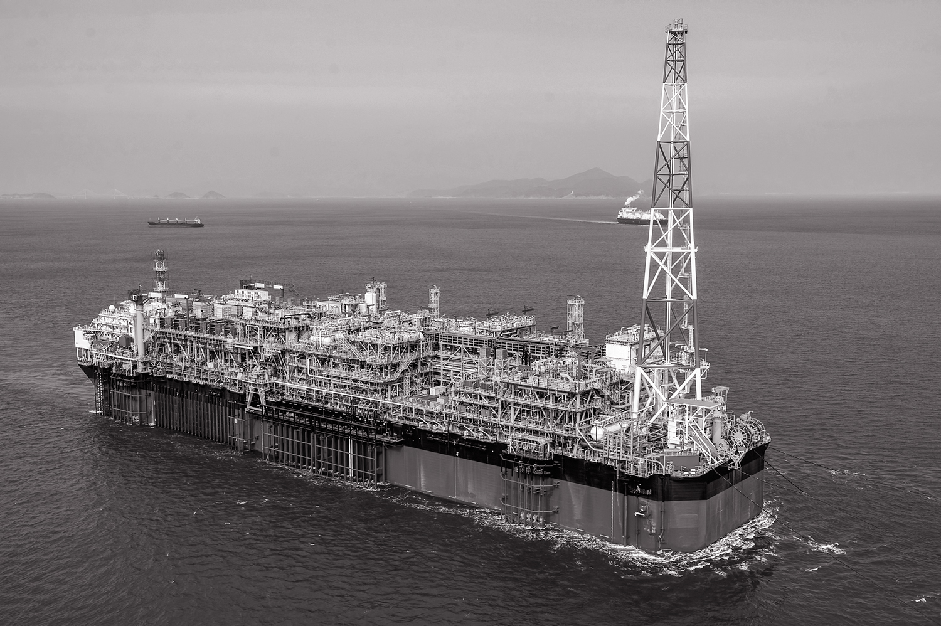
Core Bankability Issues

Slide 15
Core issues
Time | Cost | Quality | Credit/Liability
Exhaustive list of relief events Treatment of unforeseen conditions Acceptance of Employer’s Requirements/Rely Upon Information Contractual and physical interfaces Definition of Force Majeure Weather relief Change management Change orders Change in law | Exhaustive list of compensation events Currency(ies) Change management Change orders Change in law Change in prices – consumables/labour Payment terms – milestones/progress Compensation on termination | Design development Owner supplied items/interfaces Guaranteed Performance Levels Acceptance and handover Deemed completion (?) Defects correction periods Latent defects Termination rights | Transfer of title Transfer of care, custody and control Contractor credit support Bonds PCG Caps on liability Aggregate Delay LDs Performance LDs Employer L/C (?)

Slide 16
Other matters
Direct agreement and step in rights
Collateral warranties
Assignment rights
Access to information and inspection rights
ECA requirements
Eligible content
Invoicing documents
Environmental requirements

Slide 17
Limits on liability and credit enhancement
Performance bond
Warranty bond
Aggregate liability
Aggregate LDs
Delay LDs
Performance LDs
0
10
20
30
40
50
60
70
80
90
100

Slide 18
Contacts
Andrew Penfold
Ilia Ditiatev
London
andrew.penfold@linklaters.com
+44 207 456 5935
London/Moscow
ilia.ditiatev@linklaters.com
+44 207 456 4791
+7 495 797 9760

Slide 19
Linklaters LLP
One Silk Street
London EC2Y 8HQ
Tel: (+44) 20 7456 2000
Fax: (+44) 20 7456 2222
Linklaters LLP is a limited liability partnership registered in England and Wales with registered number OC326345. It is a law firm authorised and regulated by the Solicitors Regulation Authority. The term partner in relation to Linklaters LLP is used to refer to a member of Linklaters LLP or an employee or consultant of Linklaters LLP or any of its affiliated firms or entities with equivalent standing and qualifications. A list of the names of the members of Linklaters LLP together with a list of those non-members who are designated as partners and their professional qualifications is open to inspection at its registered office, One Silk Street, London EC2Y 8HQ or on www.linklaters.com and such persons are either solicitors, registered foreign lawyers or European lawyers. This document contains confidential and proprietary information. It is provided on condition that its contents are kept confidential and are not disclosed to any third party without the prior written consent of Linklaters. Please refer to www.linklaters.com/regulation for important information on our regulatory position.

