Slide 1
Top 10 ways to transform KYC operations

Slide 2
KYP – Know your presenter
Accuity – Bankers Almanac Head of KYC
~ 15 years' experience working in investment banking operations
UK-London based
Hobbies include squash and running

Slide 3
KYC Operations
1. Who is my client?
2.Can I do business with the client?
3.Should I do business with the client?
3 Fundamental Questions
1) Request for business relationship
2) Data & Document Collection
3) Due Diligence Processing
4) Screening & substantiation
5) Risk Assessment
6) QA
Policy &
Operational Processes
Governance
KYC Policy & Procedures
The Challenges
Industry challenges based on Accuity research in 2018
76% stated their #1 challenge was the rising cost to be compliant
~23% voiced reducing time spent on manual tasks as being very challenging
- Only 5% found lack of data and technology as not challenging

Slide 4
Top 10 ways to transform KYC operations
KYC
Senior Sponsorship
Governance
Policy
Data Model
Process improvements
People training
Technology
Supervisory controls & metrics
Industry insights
Continuous Improvements
Evolution

Slide 5
1. Senior Sponsorship
KYC
Why?
Support the transformation strategy
To get wider organisation buy inn
Support investment needs
Unblock barriers
Steer the course of transformation
Connecting with the outside world
Evolution

Slide 6
2. Governance
KYC
Transformation naturally does not happen overnight and equally involves multiple stakeholders
Setup up transformation governance alongside business as usual governance is a crucial ingredient for success.

Slide 7
2. Governance
KYC
Transformation Program Structure
Steering Committee
Key ingredients capture in a terms of reference for transformation :
i.e. operating model change
Define transformational goals
Design principles
Defined roles and responsible for all those involved
Information flows
Define gateways and operating rhythm
Investment and budget for transformation
Escalation channels
i.e. tracking to plan
Project Working Group
Evolution
Work Stream 1
Work Stream 2
i.e. execution of change
What will define and shape success?

Slide 8
3. Policy
2. Standardise to achieve consistency in on boarding or periodic review.
Simplify by having a minimum standard with nuances for specific categories i.e. client type or regulated/unregulated status
4. Bench mark against FATF recommendations
3. Risk based approach i.e. verification documents to be date stamped if there is associated risk factor i.e. PEP
5. Policy change impact assessment i.e. know the effort and cycle time impact.

Slide 9
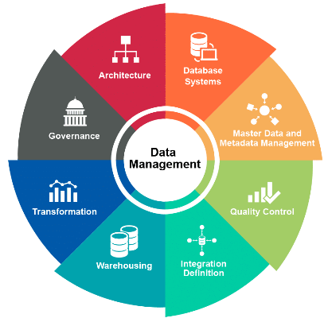
4. Data Model
Form data guiding principles;
the right data
In the right place
in the right format
at the right time.
Risk assess the data model identify what must be structured and what can remain as unstructured. What do you want to be able to report on?
Evolve to a single view of client i.e. moving away from business, product or geography based silo’s
Segment source of data in primary and secondary to demonstrate risk appetite
Explore digitalisation at source

Slide 10
5. Process Improvements
Root cause analysis to negative consequences
Majority of case not having a business sponsor
High percentage of account inactive for ~18 months
Points of escalation to get the right outcome
Pipeline management
Critical step check lists
Ideas box with reward
Increased productivity
Improved risk profile
Increase people satisfaction

Slide 11
6. People training
“Everybody is a genius. But if you judge a fish by its ability to climb a tree, it will live its whole life believing that it is stupid” – Albert Einstein
Mandatory training
Qualifications
From doing
Hindsight

Slide 12
7. Technology – the enabler to sustainable efficiency and effectiveness
Major industry trends
1. KYC Applications
Workflow
Case Mgmt.
Rules engine
KYC solutions
2. Robotics
3. Application Program Interfaces

Slide 13
9. Supervisory controls & metrics
A. Defined KYC Risk Framework
What
Why
How
Who
When
B. Key Process Controls (KPC)
Series of key process controls that achieve the framework
Defined target for each KPC
Governance
C. Measuring against KPC’s
Defined periodic testing of KPC’s
Rating design and operation effectiveness
Risk rate deficiencies and form action plans to address

Slide 14
9. Industry insights
Workshops
Conferences
Industry publications
All a wonderful source to review you own KYC transformation or see what you can learn from other facing common challenges.

Slide 15
10. Continuous Improvements
The is NO silver bullet to solve for KYC, transformation is the beginning and continuing improving will enable positive outcomes.
Identify
Plan
Execute
Review
Make it part of your day to day DNA
Have the structures in place to make it happen
Celebrate successes
Continuous Improvement

Slide 16
Q & A

