Slide 1

Bank BelVEB OJSC
CORRESPONDENT BANKING
CURRENT TRENDS
March, 28 2019

Slide 2
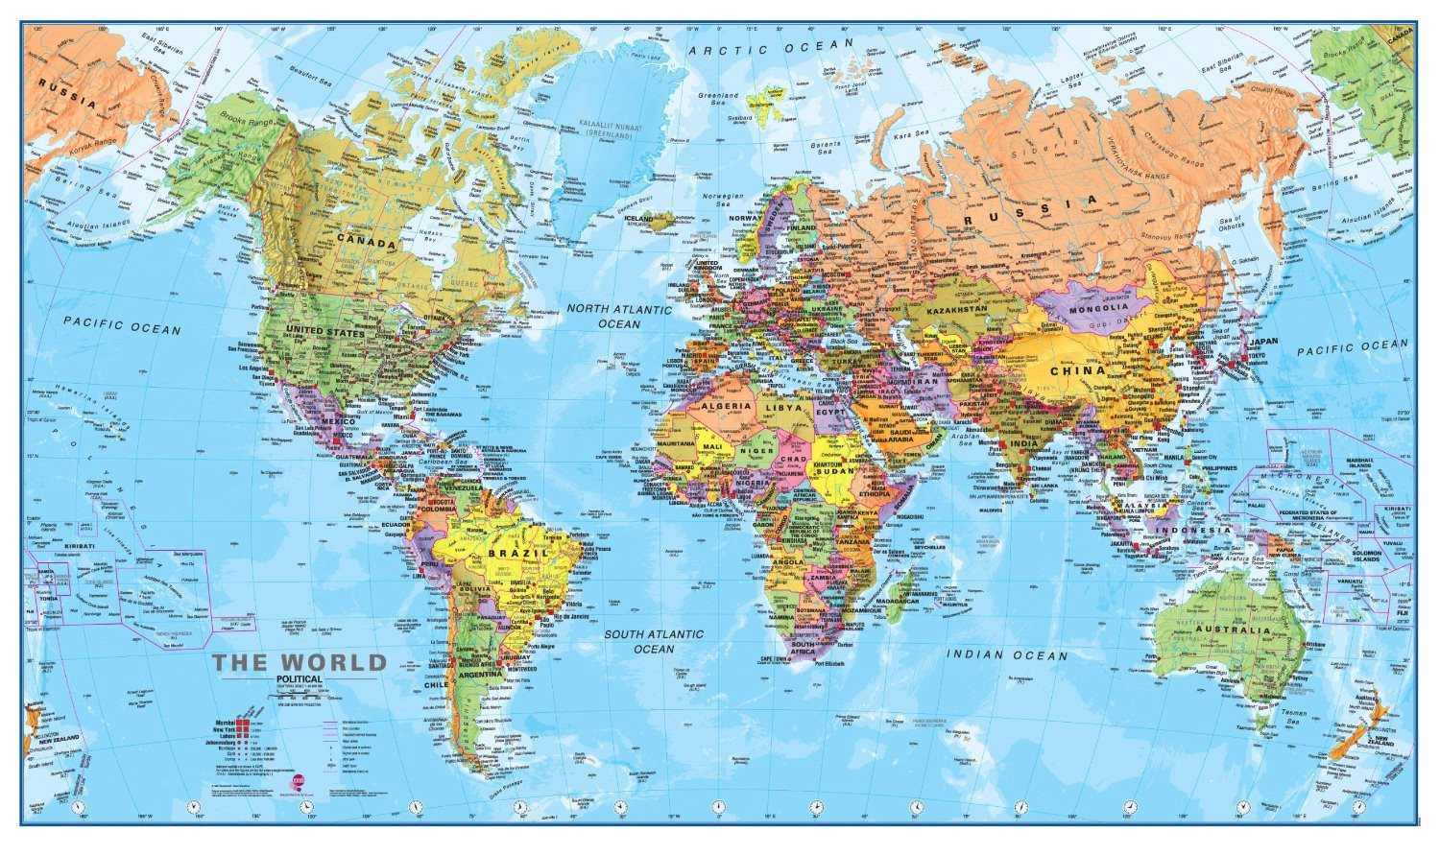
World map for Europe

Slide 3
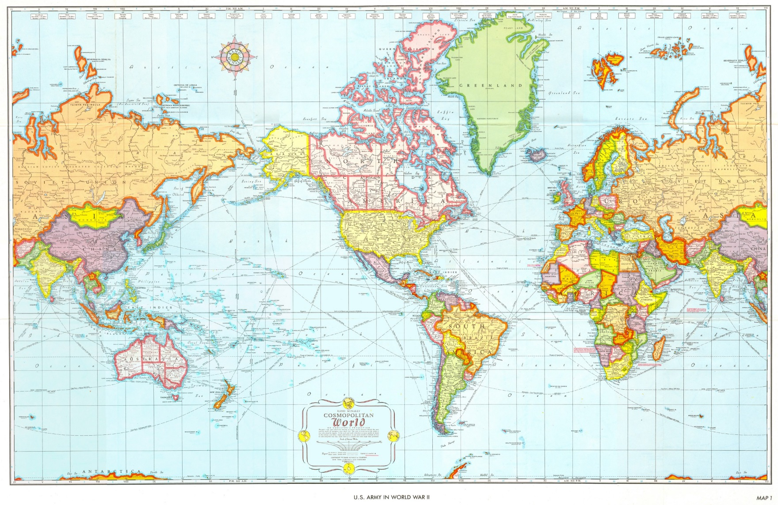
World map for USA

Slide 4
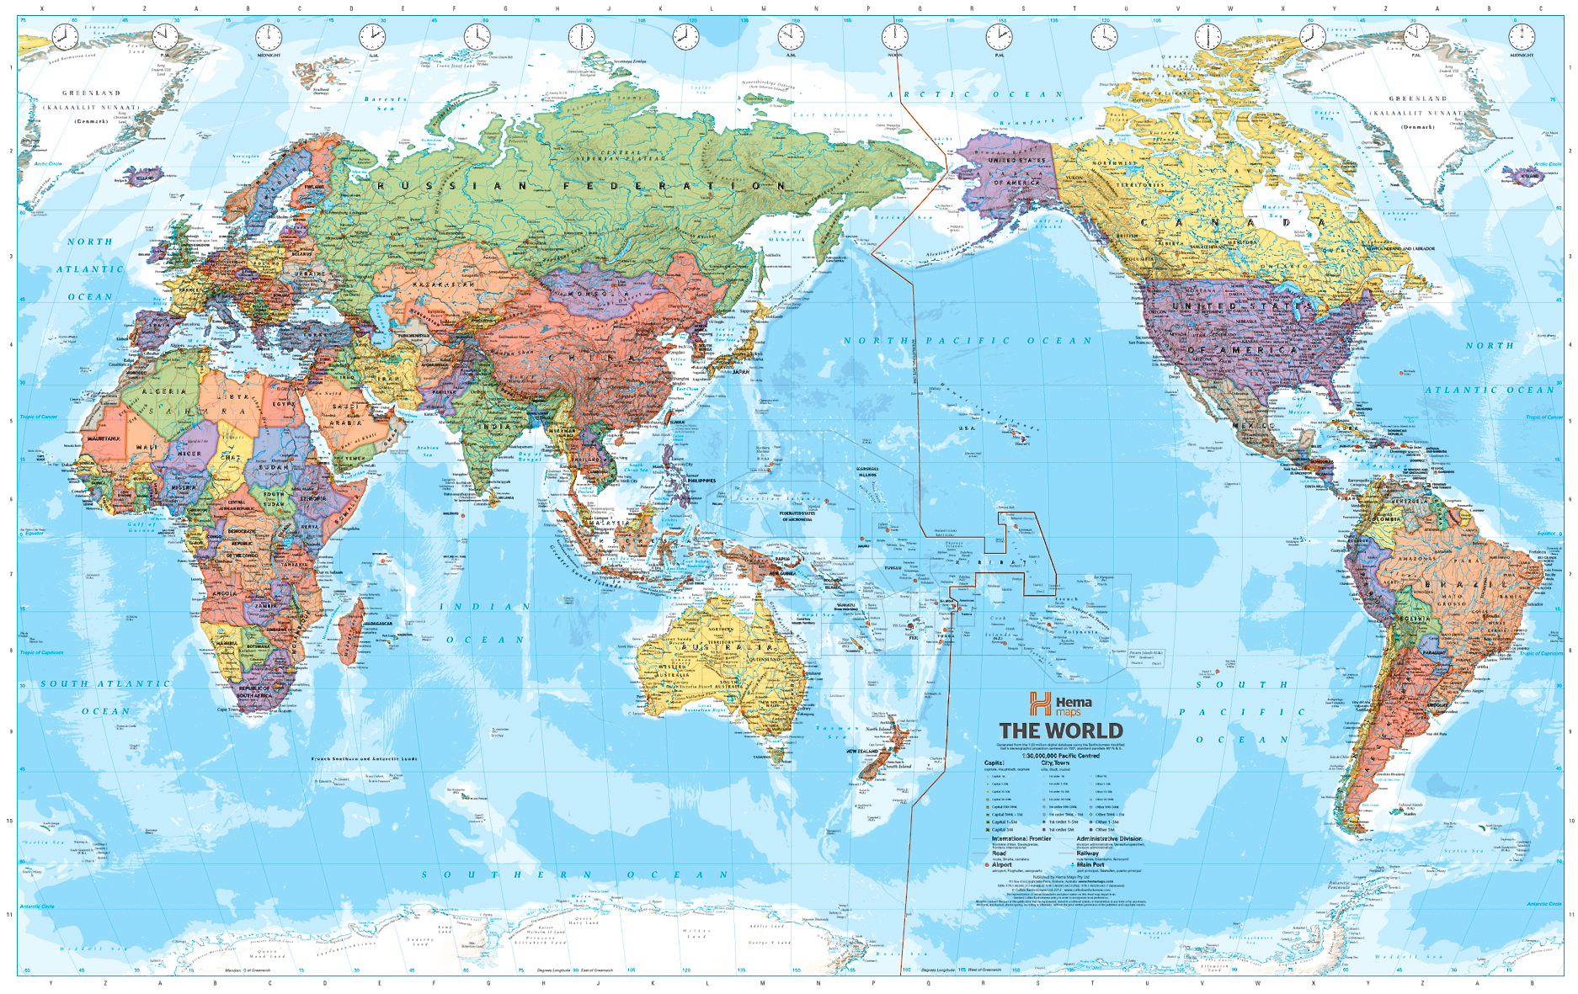
World map for CHINA

Slide 5
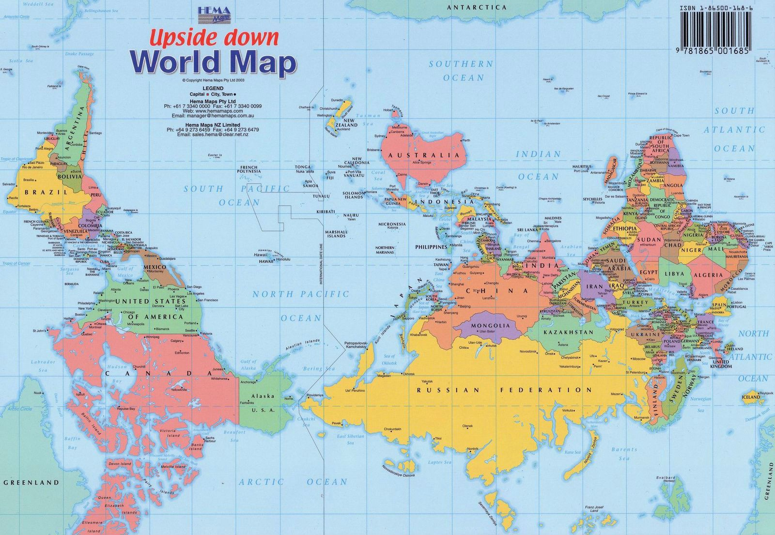
World map for Australia

Slide 6
Correspondent banking
Everything in the world is relative…
☺))))

Slide 7
Vision: correspondent banking
The strong relationships between correspondent banks drive global trade
Correspondent banking is a core business. It supports international trade and commerce with flows in many different currencies
Correspondent banking builds on the foundation that banks provide in terms of resiliency, compliance and security to enable the global trade
Correspondent banking is too important to be allowed to disappear

Slide 8
Concept of correspondent banking
in general terms
as an arrangement under which one bank (correspondent) holds deposits owned by other
banks (respondents) and provides payment services to those respondent banks
ECB refers to
agreements or contractual relationships between banks to provide payment services for
each other
Wolfsberg Group establishes that correspondent banking
is the provision of a current or other liability account, and related services, to another FI, including affiliates, used for the execution of third-party payments and trade finance, as
well as its own cash clearing, liquidity management and short-term borrowing or investment needs in a particular currency

Slide 9
Global trends in correspondent banking
Cutbacks in the number of relationships
Changes in relationships
Concentration of relationships
Difficulties in establishing or maintaining correspondent
banking relationships
Increasing costs
Cutbacks in correspondent banking services in specific foreign
currencies
Geographical imbalances
Clearing business is more and more under evaluation

Slide 10
Local market: recent changes in correspondent banking
Belarus: 27 banks and non-bank credit and financial institutions, including 4 banks with 100% foreign equity and 10 banks with over 50% foreign equity
Over the last years, there has been a strong tendency towards the termination and review of correspondent relations:
Cutback in RMA and (or) closure of correspondent accounts
Key settlement and clearing service providers (EU, USA) for Belarus’ banks highlight the following trends:
regulatory pressures/enhanced KYC/due diligence requirements
sanctions’ impact on operations worldwide
uncertainty about regulators’ decisions
review of high-risk banking products and services
reassessing the current practices
review of correspondent relations (RMA)
increase in correspondent business costs, including those arising out of strict compliance
requirements
stopping downstream correspondent banking (nested correspondents)

Slide 11
Local market: recent changes in correspondent banking
Belarus
Key USD and EUR clearing banks either stopped their business in Belarus in whole or in part (JPMorgan Chase Bank/Standard Chartered Bank/Deutsche Bank Trust Company Americas/Deutsche Bank AG) or restricted their settlements (UniCredit Bank AG/Commerzbank AG)
In terms of USD and EUR cross-border payments, forced concentration of settlement business through one or two clearing banks poses for Belarusian banks a potential risk of losing their competitive positions, when rendering a wide spectrum of settlement services to their customers
It has already become common practice for domestic banks to open correspondent accounts with financial institutions from Russia and other CIS countries with a view to making settlements via their correspondent networks
Banks began to use alternative financial information transmission channels (their own services or online apps)
There is a growing interest in the Bank of Russia financial messaging system – the Russian counterpart of SWIFT

Slide 12
Bank BelVEB’s statistics: commercial payments
НАЗВАНИЕ ПРЕЗЕНТАЦИИ
CUSTOMER TRANSFERS IN EUR, BREAKDOWN BY REGION
% of total
Predominantly customer transfers in RUB and EUR
Most of payments in EUR go to Europe and
the Baltic States
USD transfers cover various regions
CUSTOMER TRANSFERS, BREAKDOWN BY CURRENCY
% of total
CUSTOMER TRANSFERS IN USD, BREAKDOWN BY REGION
% of total

Slide 13
Further developments in correspondent banking
Correspondent banking is undergoing essential change, driven by client demand for greater efficiency, speed and transparency. This transformation will require far more collective and collaborative action among correspondent banks going forward
/. The changing nature of regulation and technology, along with new customer requirements, will force correspondent banking to modernize. Correspondent banking community needs to explore technologies such as blockchain, distributed ledgers and peer-to-peer messaging «Smart» collaboration between banks in areas such as liquidity and compliance should help to improve the practices and improve the efficiencies in correspondent banking

Slide 14
THANK YOU !
Contact: Yuliya Semenova
Financial Institutions, Head
Financial Market Operations Department

