Slide 1
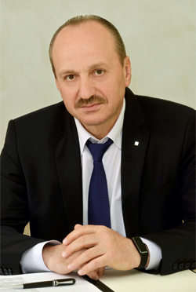
Successful experience of international projects financing.
Demands, challenges, prospects.
Aliaksandr Paliuka
First Deputy Chairman of the Board
Belarusbank is a General Partner
of the 2nd European Games
1

Slide 2
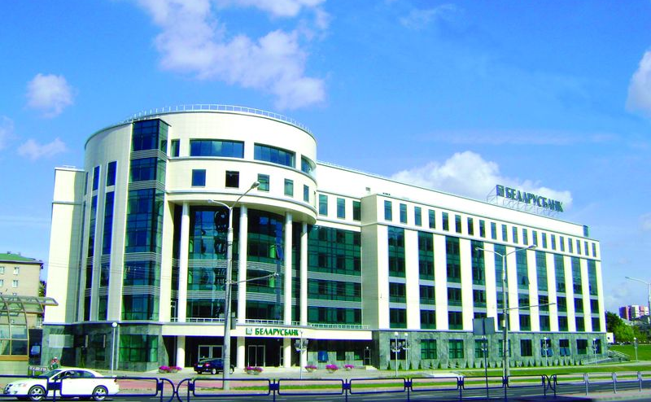
Belarusbank’s financials
NAS 2018
USD mln (in equivalent) | 01.01.2019 (without adjustments)
Profit | 157,8
CAR, % | 16,3
ROE, % | 9,3
CIR, %* | 41,5
Bank maintains the leading positions in the domestic market by authorized capital, retail, corporate and international business, %.
* the lowest figure in the banking system of Belarus
IFRS 2018
USD mln (eq.) | 2014 | 2015 | 2016 | 2017 | 1H 2018
Assets | 14 450,6 | 12 720,1 | 12 377,5 | 12 213,7 | 11 741,4
Equity | 2 094,5 | 1 425,5 | 1 446,2 | 1 534,8 | 1 473,7
Net profit | 110,6 | 65,7 | 123,9 | 122,8 | 109,8
Customer deposits | 8 936,3 | 7 714,2 | 7 623,0 | 7 529,3 | 7 385,5
Loans to customers | 9 461,2 | 6 608,2 | 6 526,5 | 7 361,8 | 7 666,5
Corporate clients (number) | 89 146 | 82 434 | 79 722 | 80 306 | 81 794
2

Slide 3
Belarusbank. Market position
Liabilities and Equity (Resource Base) as of 01.01.2019, USD bn (eq.)
Equity as of 01.01.2019,
USD bn (eq.)
Bank Loans to Economy as of 01.01.2019,
USD bn (eq.)
Corporate and Retail Deposits as of 01.01.2019,
USD bn (eq.)
Source: Bulletin of Banking Statistics of National Bank of the Republic of Belarus
3

Slide 4
Successful experience of international project financing.
Demands, challenges, prospects.
The 2nd European Games 2019 will be held in Minsk from 21 June to 30 June 2019. The games will feature 199 events in 15 sports.
4

Slide 5
corporate business. TRENDS
Loan Portfolio
Major high-profile clients
CORPORATE BUSINESS.
Demand&Challenges.
The official mascot of the 2nd European Games Lesik the Little Fox. The green color on the mascot shirt designates development and harmony, and the black shorts indicate discipline and determination. The yellow fur speaks of his cheerfulness, the blue shoes identify the invincibility of our character, and red color reflects his vigor.
5

Slide 6
Corporate Business
Funding base of Belarusbank in the banking system, %
Number of corporate clients
more than 82 000
Clients base structure, %
Belarusbank’s share of the corporate loans market, %
+2,1%
Since the beginning
of the year
6

Slide 7
Loan portfolio
7

Slide 8
Major high-profile clients of Belarusbank
Minskenergo
8

Slide 9
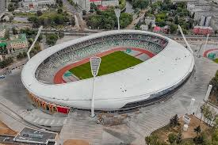
CORRESPONDENT BANKING
TRADE FINANCE
ECA
INTERNATIONAL BUSINESS. Challenges&Demands.
Dinamo Stadium in Minsk reopened after a large-scale six-year renovation on 21 June. One of the city’s landmarks and the country’s main sports arena that hosted the 1980 Summer Olympics is enjoying a new lease on life as it welcomed a new generation of athletes and spectators. In a year the arena will host the 2nd European Games .
9

Slide 10
International business
Correspondence banking
NOSTRO | LORO
81 accounts | 120 accounts
In 37 banks In 13 countries In 15 currencies | 89 – banks-residents 31 – banks-non residents
In March 2018 a Loan Agreement regarding provision of post financing was concluded with VTB bank (Russia)
In December 2018 a syndicated loan in the amount of EUR 151 mln was attracted from 14 financial institutions
Gross volume of attracted financing in 2018, USD mln in equivalent
10

Slide 11
Selected Transactions in 2018
The Lender The Borrower
The Lender The Borrower
The Lender The Borrower
Credit facility agreement
Finance Contract for
SME financing
Russian suppliers
Mogilevenergo
USD 30 mln
EUR 37 mln
EUR 25 mln
May 2018
September 2018
November 2018
11

Slide 12
Trade finance. Documentary operations.
New cooperation
under documentary operations with:
Sberbank CZ, a.s. (Czech Republic)
Bank Saint-Petersburg (Russian Federation)
CITI Bank (Hungary)
Renovated cooperation
under documentary operations:
Danske Bank (Denmark
Nordea Bank AB (Finland)
Bayerische Landesbank (Germany)
2018
371
documentary
letters of credit
565
USD mln
in equivalent
Credit Suisse (Switzerland) Ltd.
International Bank for Economic Cooperation
12

Slide 13
Trade Finance. Achievements & Challenges
Trade financing gross volume dynamics, USD in equiv.
Geography of trade finance, 01.01.2019
1477
770
Most active lenders in 2018:
TOP clients in trade finance
19 trade loans for EUR 220 mln
14 trade loans for
EUR 294 mln
11 trade loans for EUR 112 mln
7 trade loans for EUR 74 mln
In 2018 the Basic Agreement were signed with Russian Sovcombank and Bank Saint Petersburg.
13

Slide 14
ECA business
* Such countries as Taiwan, Norway, Denmark, Netherlands, Belgium, Finland, Austria have ratio less than 1%.
Top Countries in ECA-covered financing:
China
Germany
Poland
Czech Republic
14

Slide 15
Esteemed partners.
Achievements
2018
2019
Switzerland
Confirming bank agreement
Finance Contract
for SME financing
EUR 25 mln
Basic Loan
Agreement
Long-standing cooperation
15

Slide 16
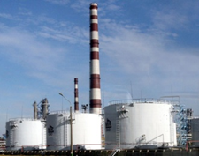
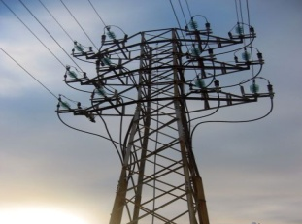
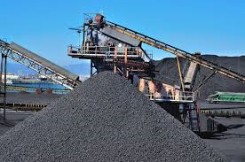
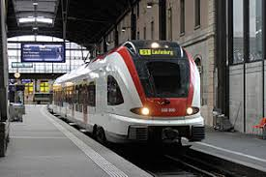
Prospects
Petrochemicals
Energy
Mining industry
Modernization of railway rolling stock
Engineering
16

Slide 17
Thank your for your attention!
Looking forward to further cooperation!

